Slide 1
Digital Image Acquisition, Sampling and Quantization

Slide 2
Outline
Human Visual System
Image Acquisition
Sampling and Quantization
Image Sensors

Slide 3
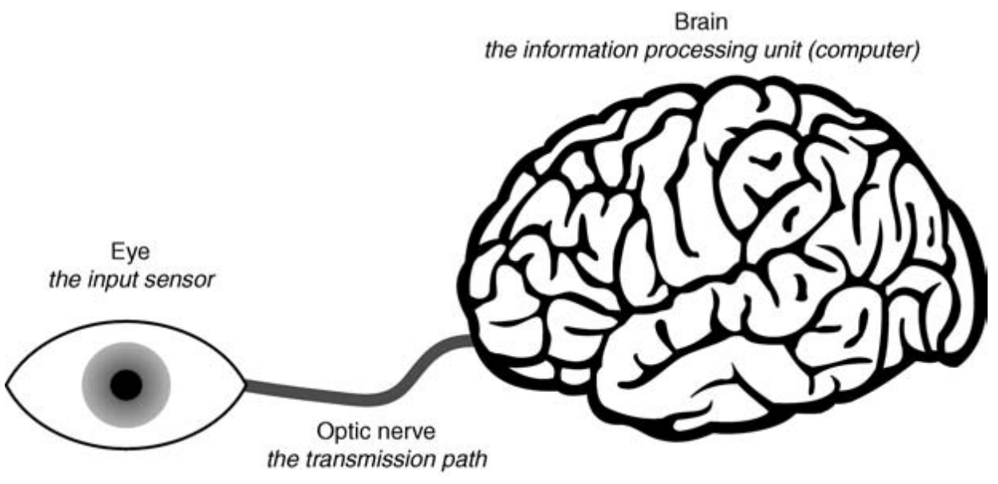
Human Visual System
The human visual system (HVS) consists of two basic components, the eye and the brain which are connected by the optic nerve.
  Eye (input sensor)
  Brain (information processing unit)
  Optic nerve (transmission path)
The good understanding of HVS can be very helpful in understanding the computer vision systems (CVS).
The goal of CVS is to emulate or ultimately outperform the HVS.

Slide 4
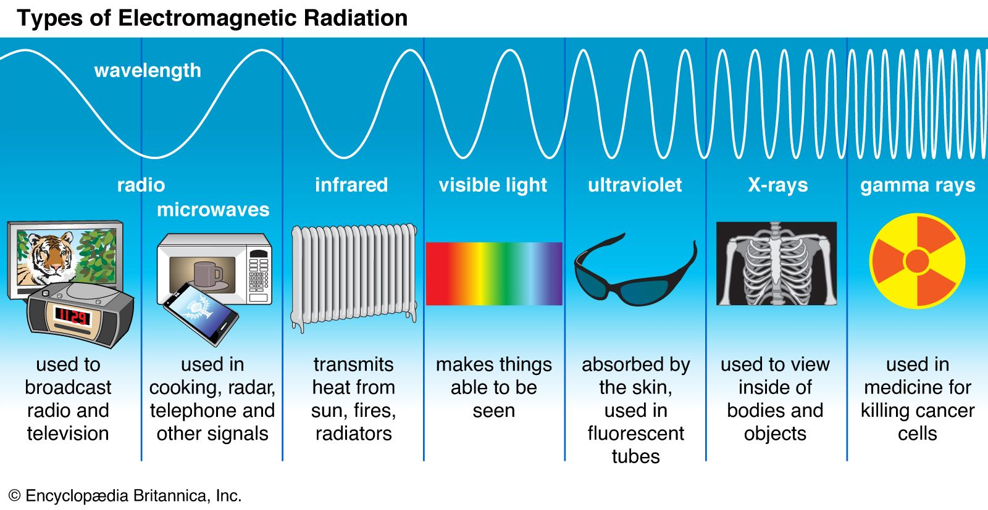

Slide 5
Human Visual System
The function of HVS is to detect the Electromagnetic Radiation (EMR) emitted by the objects.
Humans can detect light wavelength between 400-700 nm. The perceived color (hue) depends on the wavelength of light and brightness is related to intensity of the radiation.

Slide 6
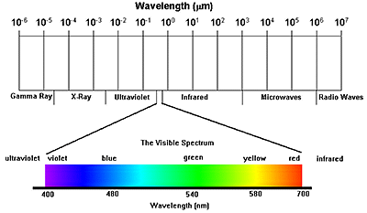
Human Visual System
The visible spectrum can be divided into three bands:
Blue (400-500 nm)
Green (500-600 nm)
Red (600-700 nm)

Slide 7
Human Visual System
How do we see the Objects?
Light helps us to see the objects.
When light hits the object it may be absorbed, transmitted or reflected depending on the material of an object.
When it hits an opaque object, some light is absorbed and the rest is reflected.
If the object is transparent, light rays pass through it completely.
If the object is translucent (semi transparent), some light can pass through, but the rest of the light will be reflected.

Slide 8
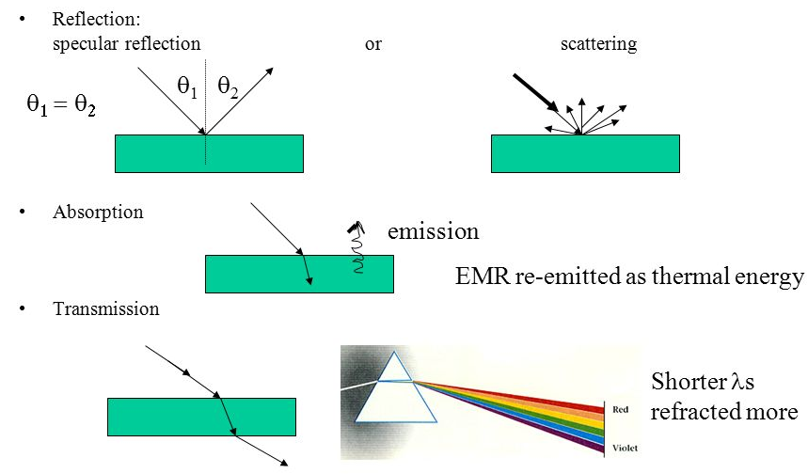
Light incidence and reflection

Slide 9

Image Acquisition

Slide 10
Image description
f (x,y): intensity/brightness of the image at spatial coordinates (x,y)
0< f (x,y)<∞ and determined by 2 factors:
illumination component i(x,y): amount of source light incident
reflectance component r(x,y): amount of light reflected by objects
f (x,y) = i(x,y) r(x,y)
where
0< i(x,y)<∞: determined by the light source
0< r(x,y)<1: determined by the characteristics of objects

Slide 11

Sampling and Quantization
quantization
sampling

Slide 12
Sampling and Quantization
Sampling: Digitization of the spatial coordinates (x,y)
Quantization: Digitization in amplitude (also called gray- level quantization)
8 bit quantization: 2⁸ = 256 gray levels (0: black, 255: white)
Binary (1 bit quantization): 2 gray levels (0: black, 1: white)
Commonly used number of samples (resolution)
Digital still cameras: 640x480, 1024x1024, 4064 x 2704 so on
Digital video cameras: 640x480 at 30 frames/second 1920x1080 at 60 f/s (HDTV)

Slide 13
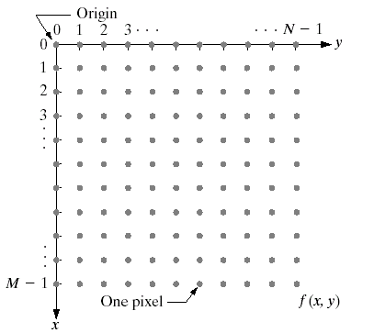
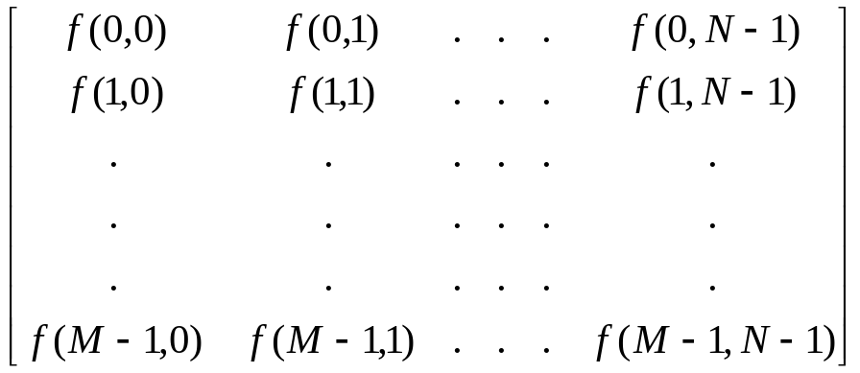
Sampling and Quantization
An M x N digital image is expressed as
Columns
Rows
N : No of Columns
M : No of Rows

Slide 14
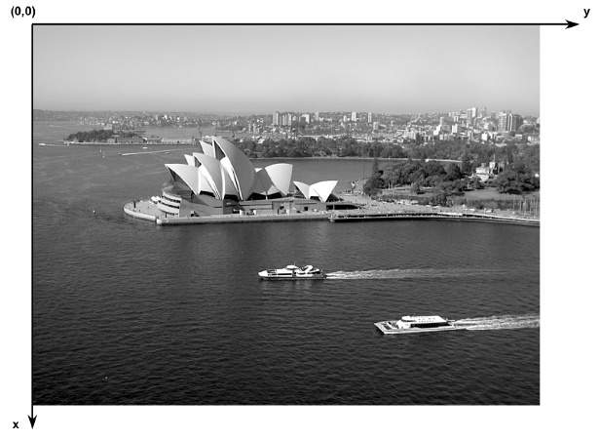
Sampling and Quantization
Image coordinate convention
There is no universally accepted convention or notation. Always check carefully!

Slide 15
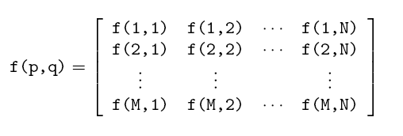
Sampling and Quantization

Slide 16
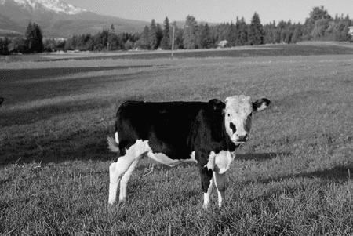
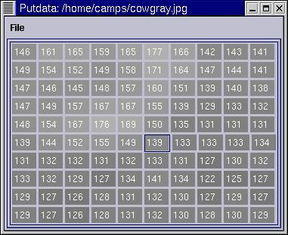
Digital Images
Digital images are 2D arrays (matrices) of numbers:

Slide 17
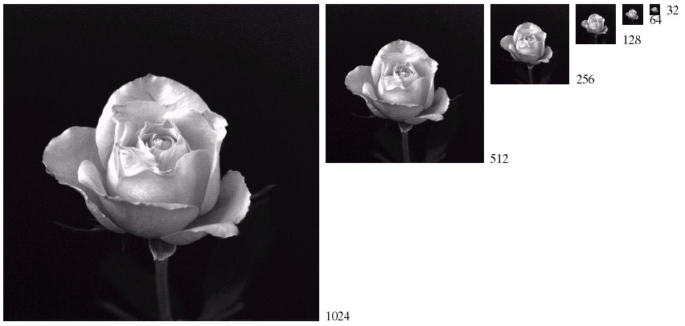
Sampling

Slide 18
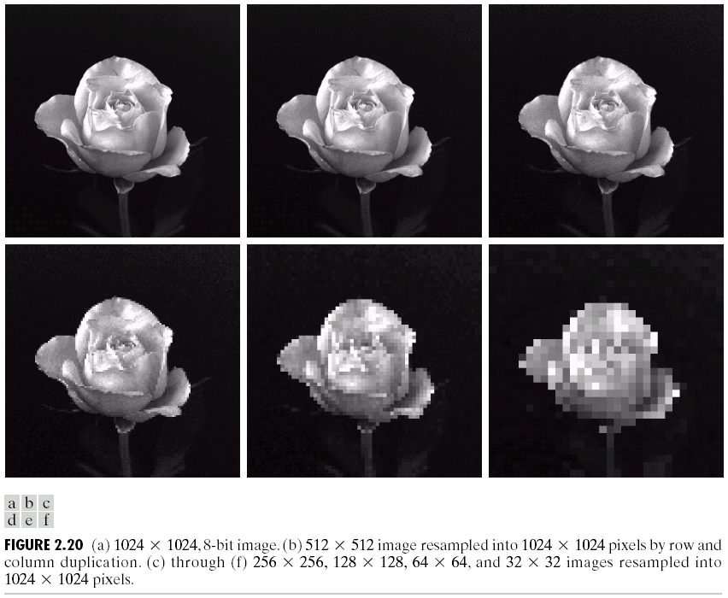
Sampling
COMSATS Institute of Information Technology, Lahore Digital Image Processing CSC331

Slide 19



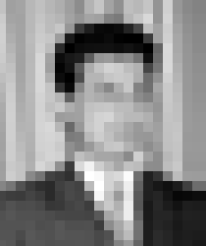




Effect of Sampling and Quantization
250 x 210 samples
125 x 105 samples
50 x 42 samples
25 x 21 samples
16 gray levels
8 gray levels
4 gray levels
Binary image

Slide 20

Effect of Sampling and Quantization

Slide 21

Effect of Sampling and Quantization

Slide 22
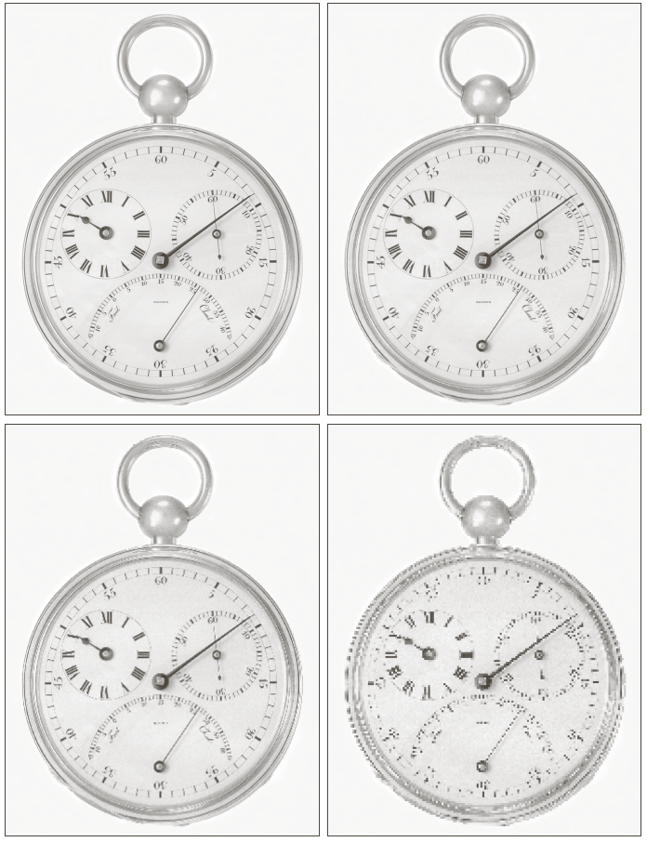
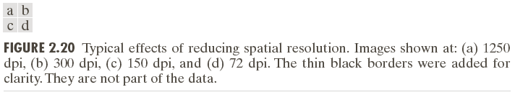
Effect of Sampling and Quantization

Slide 23
Python Implementation
Following Python libraries are typically used:
  matplotlib for plotting and
  OpenCV or PIL (Pillow) for image manipulation.
Some common operations are:
imread() – Reading an Image
  Python (using OpenCV): cv2.imread(filename, flags)
  Python (using PIL/Pillow): Image.open(filename)
  Purpose: To read an image from a file into an array. The flags in OpenCV allow you to specify the color mode (e.g., grayscale, color, unchanged).
COMSATS Institute of Information Technology, Lahore Digital Image Processing CSC331

Slide 24
Python Implementation
Some common operations are:
  imresize() – Resizing an Image
  Python (using OpenCV): cv2.resize(src, (width, height))
  Python (using PIL/Pillow): Image.resize((width, height))
  Purpose: To resize an image to the specified size.
  figure – Opening a New Graphical Window
  Python (using matplotlib): plt.figure()
  Purpose: To create a new figure window for plotting. In Python with matplotlib, this creates a new figure object.
COMSATS Institute of Information Technology, Lahore Digital Image Processing CSC331

Slide 25
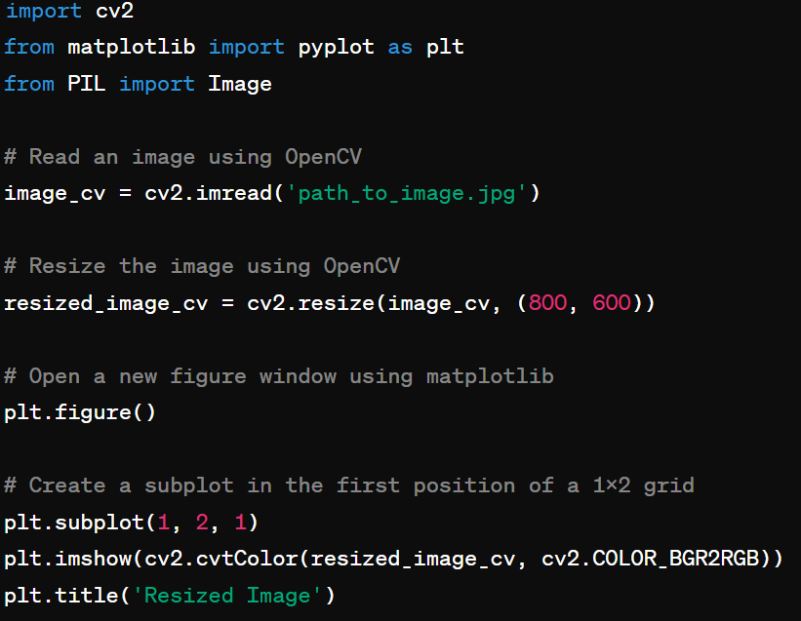
Python Implementation
COMSATS Institute of Information Technology, Lahore Digital Image Processing CSC331

Slide 26
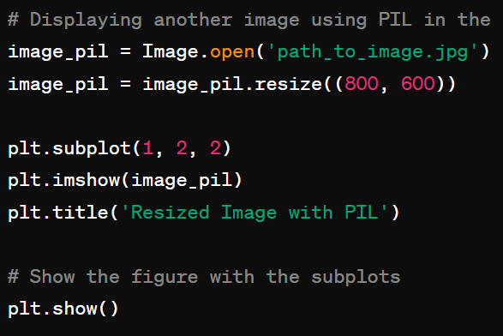
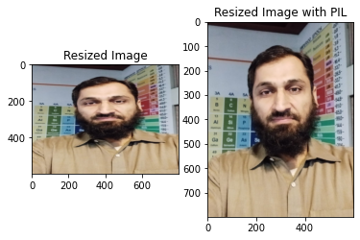
Python Implementation
COMSATS Institute of Information Technology, Lahore Digital Image Processing CSC331

Slide 27
Image Sensors
Goal: to convert EM energy into electrical signals that can be processed, displayed and/or interpreted as images.
Common technologies:
  CCDs (charge-coupled devices)
  CMOS (complementary metal oxide semiconductor)

Slide 28
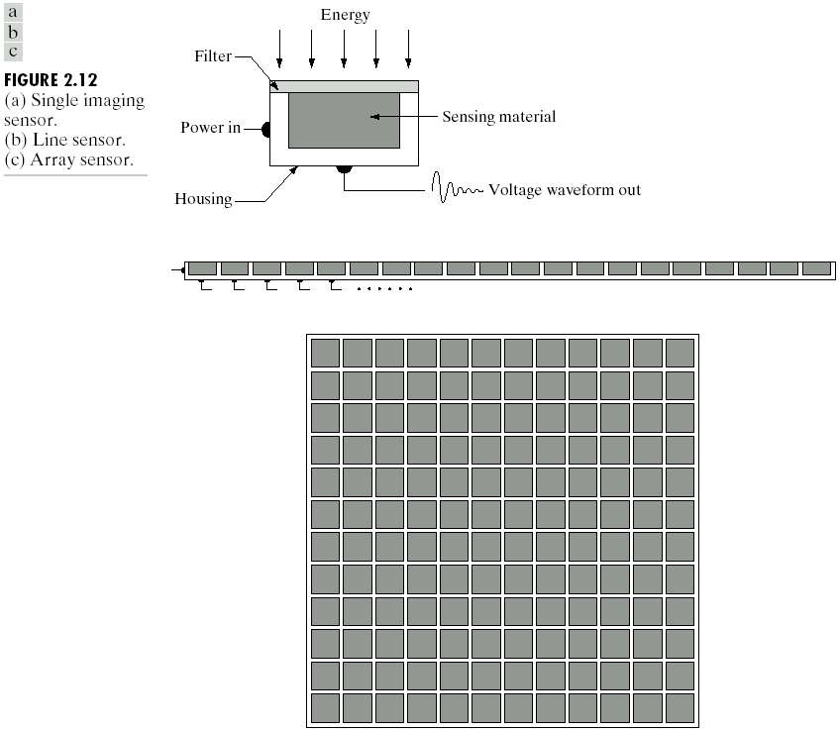
Image Sensors
Single imaging sensor
Line sensor
Array sensor

Slide 29
Image Sensors (Contd.)
In image acquisition, different types of sensors are used to capture visual information from the environment. These sensors can vary in complexity from single photodetectors to complex arrays.
Single Imaging Sensor
  A single imaging sensor is a photodetector that measures the intensity of light in one point in space.
  These sensors can only detect the presence or absence of light or measure the brightness level of a single point.

Slide 30
Image Sensors (Contd.)
Line Sensor
  A line sensor consists of an array of photodetectors arranged in a straight line.
  This sensor captures data across a one-dimensional space and is often used to scan objects moving past the sensor.

Slide 31
Image Sensors (Contd.)
Array Sensor
Array sensors consist of a two-dimensional array of photodetectors, each capturing a small portion of the scene.
When combined, these detectors provide a complete two-dimensional image.

Slide 32
Comparing Image Sensors
Single Imaging Sensor: Since they only capture a single data point at a time, single imaging sensors cannot capture images or detailed information about the spatial distribution of light.
Line Sensor: They offer higher resolution and are faster than single sensors because they can capture a line of data points simultaneously. When used in conjunction with mechanical movements, they can build up a two-dimensional image over time.

Slide 33
Comparing Image Acquisition Sensors
Array Sensor: Array sensors can capture complex visual scenes with spatial relationships between different parts of the scene. They provide a comprehensive view in a single snapshot, making them suitable for a wide range of applications, including surveillance, astronomy, and medical imaging.

Slide 34
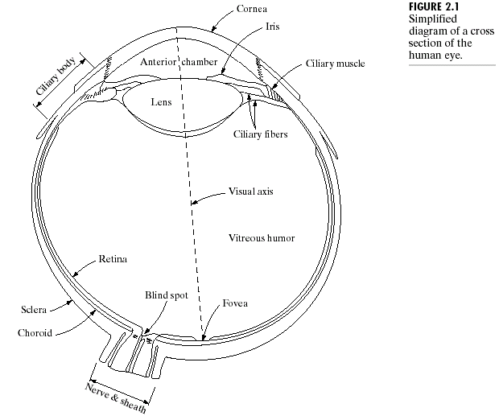
Structure of a Human Eye
The eye is enclosed by three membranes:
  Cornea and Sclera are outer covers (cornea is transparent while sclera is opaque)
  Choroid
  Retina
The eye contains a lens responsible for focusing an image. The movements of the lens are controlled by specialized ciliary muscles.

Slide 35
Structure of a Human Eye
The anterior portion of the lens contains an iris diaphragm responsible for controlling the amount of light that enters the eye.
The innermost membrane of the eye is the retina, which is coated with photosensitive receptors called cones and rods.
It is on the surface of the retina that an upside-down image of the scene is formed.

Slide 36
Structure of a Human Eye
The classes of receptors are: cones and rods.
  The number of cones in each eye: 6 to 7 millions
  The number of rods in each eye: 75 to 150 millions
  The cones are concentrated in the central portion of the retina (fovea).
  The rods are distributed over the retinal surface.`

Slide 37
Structure of a Human Eye
Photopic (bright-light) vision: vision with cones
  Color receptors: highly sensitive to colors but less sensitive to light.
  Each cone is connected to its own nerve end, therefore human can resolve fine details of colors.
  High resolution in the fovea.
  Color blind, lower resolution
Scotopic (dim-light) vision: vision with rods
  Give a general overall picture of field of view, not involved in color vision
  Much more sensitive to light (night vision)
  Several rods are connected to a single nerve
  We can see in dark room as well as in bright room but not at the same time.

Slide 38
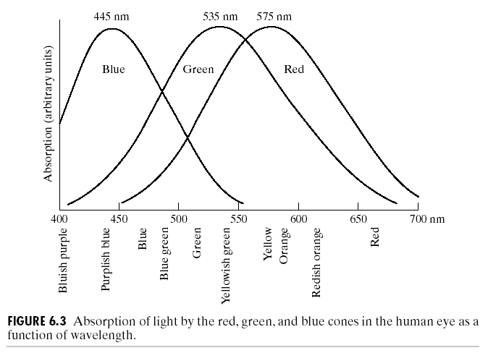
Structure of a Human Eye
Color is sensed by the eye using three kinds of cones, each sensitive primarily to red, green or blue, though there is significant overlap.
The International Commission on Illumination in 1931, referred to red, green and blue as the primary colors,
and denote to set as RGB:
blue = 435.8nm
green = 546.1nm
red = 700nm
Approximately:
65% cones are sensitive to red
33% cones are sensitive to green
2% cones are sensitive to blue
(but the blue cones are most sensitive)
Improved analysis in 1965

